Slide 1
ROUND KEY-BASED CRYPTOGRAPHY SYSTEM
Team Details
Megha Parate (20EG105425)
Are Jagannath Rao (20EG105456)
Bharath Kandimalla(20EG105457)
Project Supervisor
B. Ravinder Reddy
Assistant Professor
Dept. of CSE

Slide 2
Introduction
The "Round key-based hybrid cryptography system" is a combination of two classical ciphers Vigenere and polybius ciphers, we introduce a round key as an additional layer of security.
The developing environment is Python 3.10
It allows confidential information to be securely encrypted, ensuring privacy and confidentiality during data transmission.
The applications span various domains, including secure communication, sensitive documents, secure file sharing, etc.

Slide 3
Literature
Sl.no | Author (s) | Method | Advantages | Disadvantages
1 | Shivam Vatshayan, Raza Abbas Haidri, Jitendra Kumar Verma | Design of hybrid cryptography system based on vigenere cipher and polybius cipher | More secure than classical ciphers | Vulnerable to Frequency analysis attack, Kasiski attack
2 | Miss. Pradnya Patil, Prof. S. S. Redekar | Hybrid Vigenere Polybius cipher with XOR operation for enhanced Cryptography | Security against Kasiski attack | Vulnerable to Frequency analysis attack, men in the middle attack, fault analysis attack
3 | Aditi Saraswata , Chahat Khatria , Sudhakara , Prateek Thakrala , Prantik Biswasa | An Extended Hybridization of Vigenere and Caesar Cipher Techniques for Secure Communication | extended the vigenere table by including the digits in the table so that numerical data can also be encrypted using the new proposed table. | Vulnerable to Frequency analysis attack

Slide 4
4 | Sazzad Hossain Saju, Sayed Mahmudul Haque, Liakot Hossain Lingcon | A Hybrid Cryptographic Scheme of Modified Vigenère Cipher using Randomized Approach for Enhancing Data Security | Security against Kasiski attack | Vulnerable to Frequency analysis attack if the key size is small
5 | Ayman Al-ahwal , Sameh Farid | The Effect Of Varying Key Length On A Vigenère Cipher | Security against Frequency analysis attack with large key length | Performance is compromised when the key size is larger

Slide 5
Problem Statement
The Combination of the Vigenere and Polybius ciphers in a hybrid cryptographic system provides a foundation for secure data communication. However, this system is vulnerable to frequency analysis attack, which exploit patterns in the ciphertext to deduce the underlying plaintext.

Slide 6
Objective
The solution for the above problem is the proposed method -
“To design a hybrid cryptographic system combining two classical ciphers, vigenere and polybius cipher by adding the concept of round key as an additional layer of security which is more resistant to frequency analysis attack as the letter frequencies are masked and vary across different rounds.”
The parameters which are considered for the project evaluation are:
→ Kasiski test
→ Frequency analysis
→ index of coincidence

Slide 7
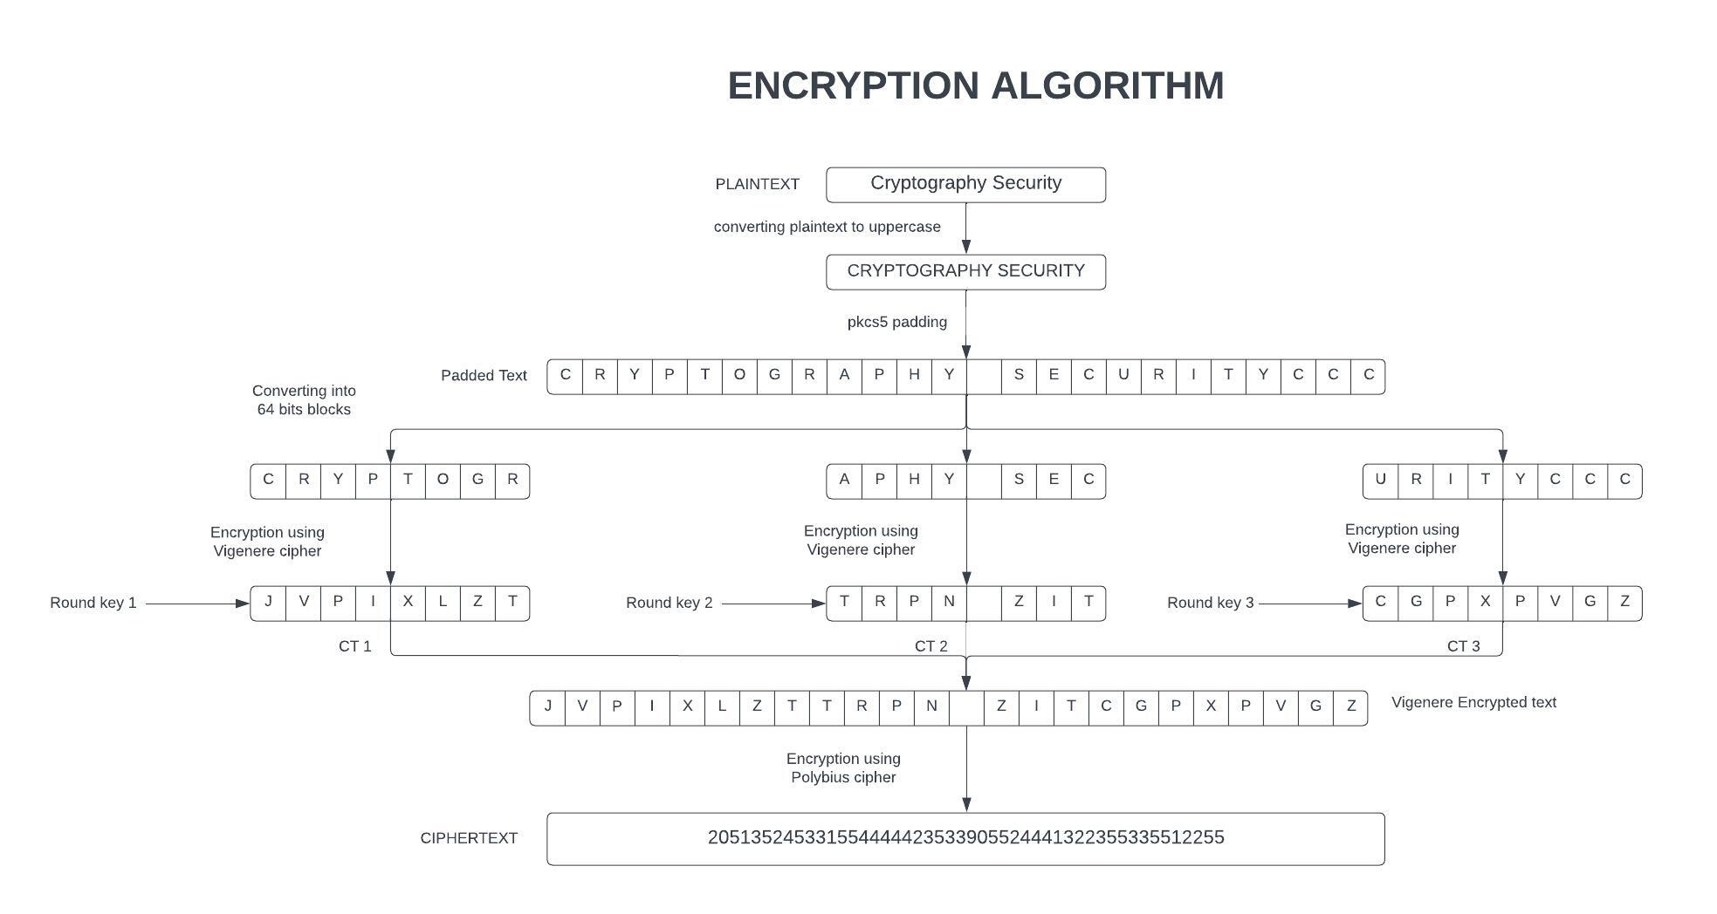
Proposed Method
The proposed method is “Round key based hybrid cryptography system”.
INPUTS: Plaintext, Key.

Slide 8
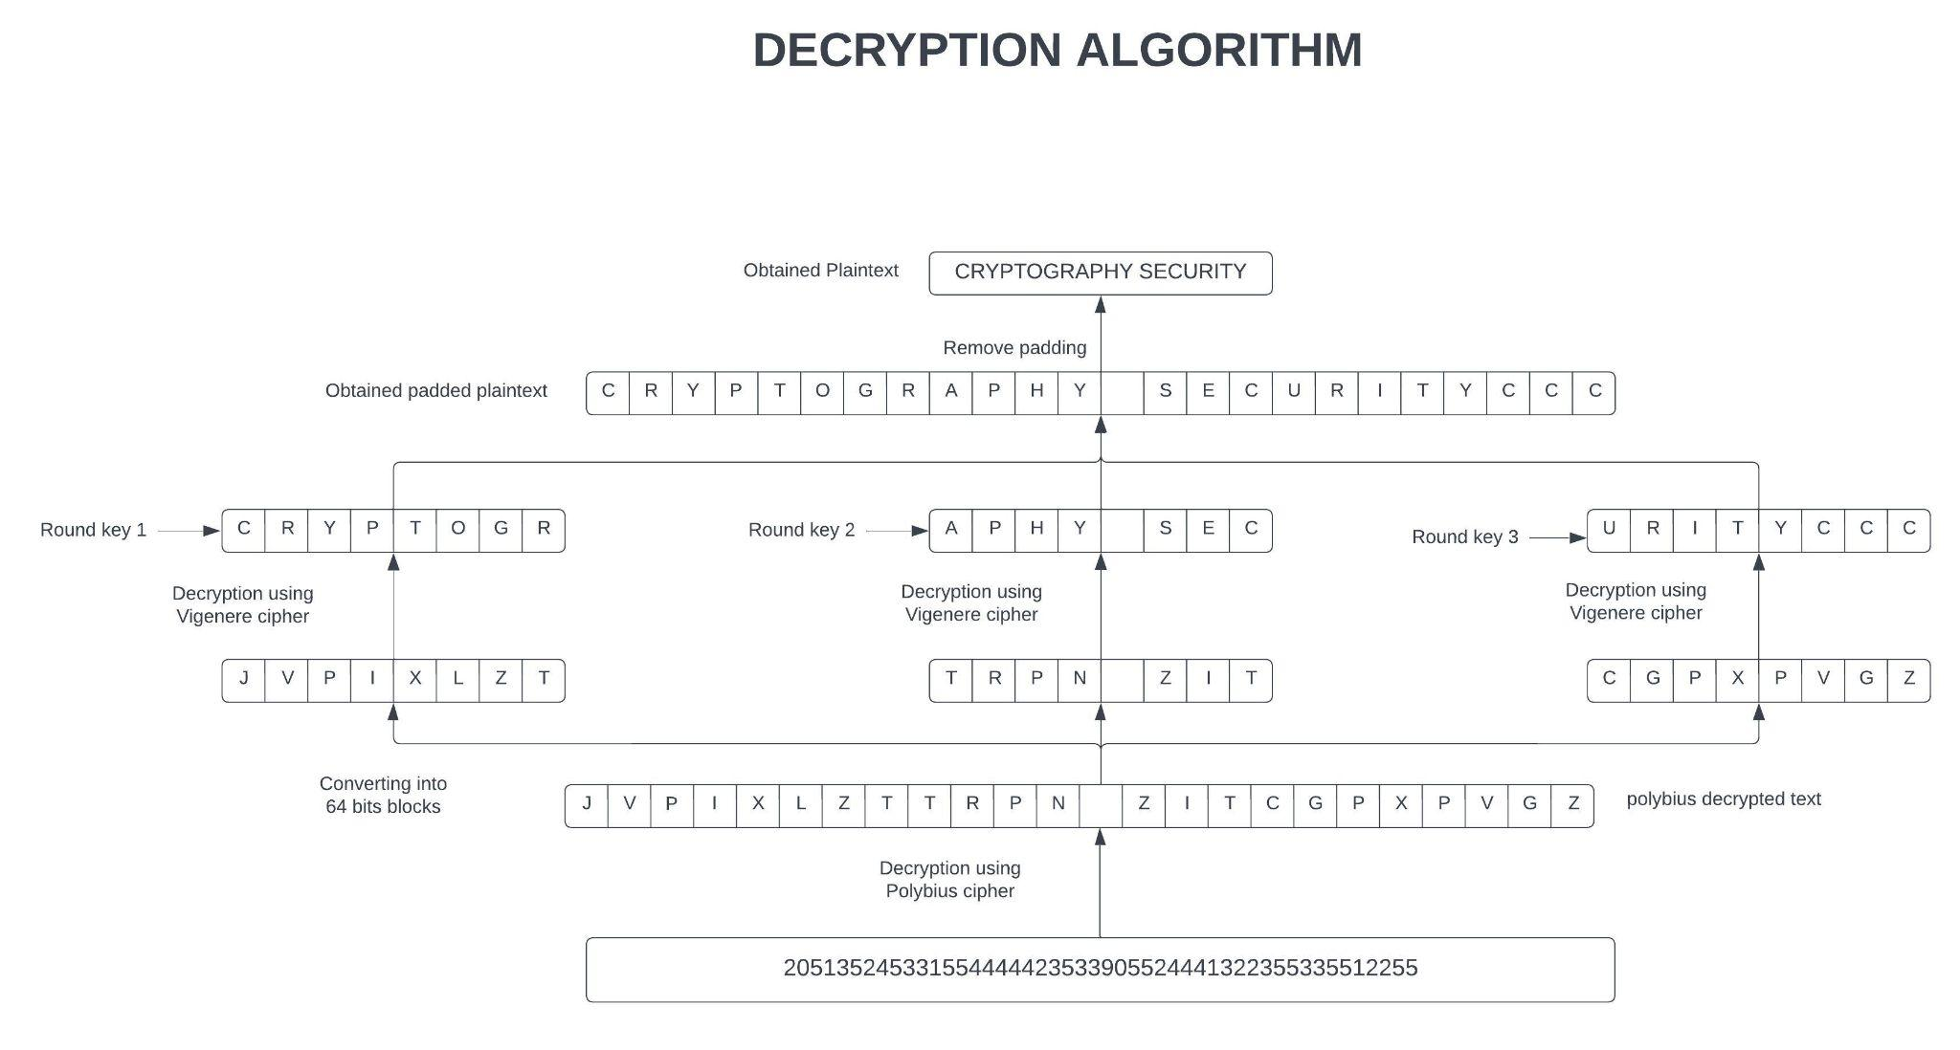
Proposed Method

Slide 9
Project Status
Sl.No | List of Functions | Status
01 | Plaintext and key input | Completed
02 | Data preprocessing | Completed
03 | PKCS5 Padding | Completed
04 | Random number generation | Completed
05 | Encrypt using Vigenere Cipher | Completed
06 | Encrypt using Polybius Cipher | In progress
07 | Decrypt using Polybius cipher | Not yet started
08 | Decrypt using Vigenere cipher | Not yet started
09 | Unpadding | Not yet started
10 | Display Plaintext | Not yet started

Slide 10
References
IEEE Paper – Design of hybrid cryptography system based on vigenere cipher and polybius cipher.
https://www.geeksforgeeks.org/block-cipher-modes-of-operation/
https://www.geeksforgeeks.org/feistel-cipher/
https://www.geeksforgeeks.org/feistel-cipher/https://www.geeksforgeeks.org/advanced-encryption-standard-aes/

